Slide 1
CHAPTER 2
LIMITS AND CONTINUITY

Slide 2
CONTENTS
2.1. The Tangent & Velocity Problems
2.2. The Limit of a Function
2.3. Calculating Limits using the Limit Laws
2.4. Continuity
2.5. Limits involving Infinity
2.6. Limits of Sequences

Slide 3
2.1 THE TANGENT AND VELOCITY PROBLEMS
2.1.1. The Tangent Problem
2.1.2. The Velocity Problem

Slide 4
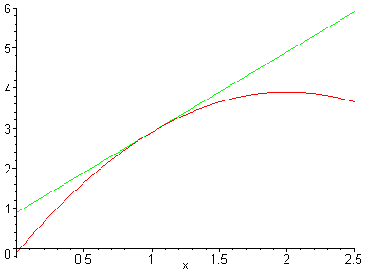
2.1.1 The Tangent Problem
t
P
The tangent t to the curve y = f(x) at point P is determined by its slope m

Slide 5
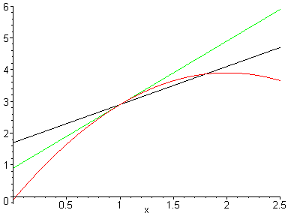
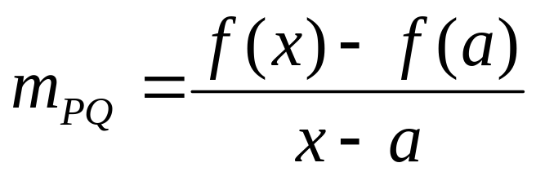
We can approximate m by the slope m_{PQ} of a secant PQ, where Q is a nearby point
t
P
Q

Slide 6
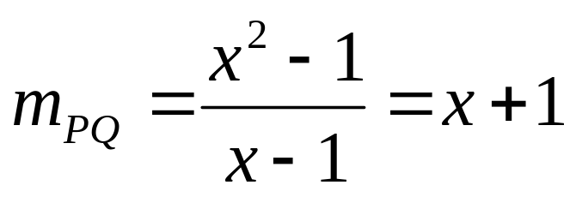
Example. Find the equation of the tangent line to the parabola y = x² at the point P(1,1)
Solution. We can approximate the slope m at P by the slope m_{PQ} of a secant PQ, where Q (x, x²) is a nearby point
For instance with Q(1.5, 2.25) we have
m_{PQ} = 1.5 + 1 = 2.5

Slide 7
In the following tables we compute the slope of the secant passing through P and a nearby point Q with x-coordinate approaching 1
x | m_{PQ}
2 | 3
1.5 | 2.5
1.1 | 2.1
1.01 | 2.01
1.001 | 2.001
x | m_{PQ}
0 | 1
0.5 | 1.5
0.9 | 1.9
0.99 | 1.99
0.999 | 1.999
When Q approaches P (x is close to 1) then m_{PQ} approaches 2

Slide 8
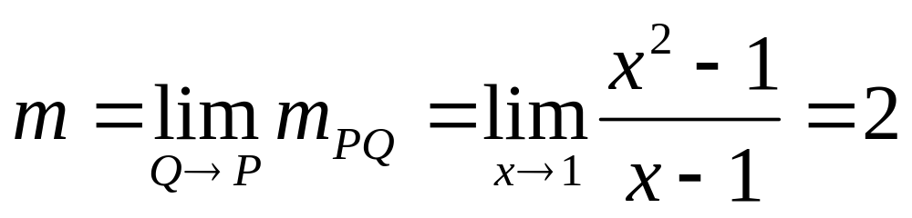
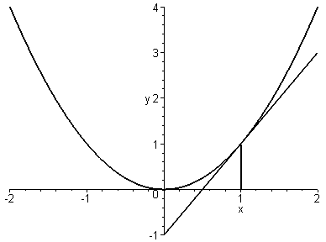

Slide 9
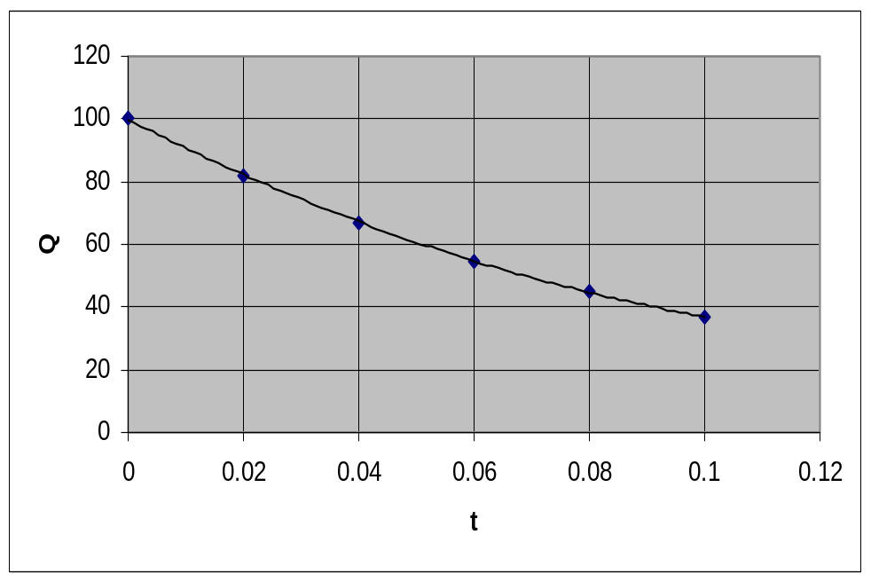
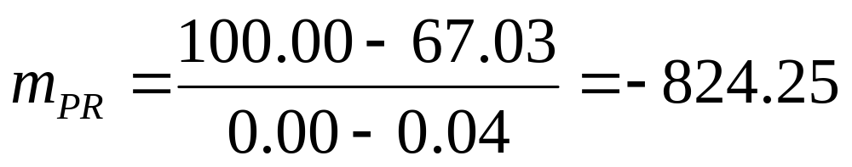
Example. The charge Q remaining on the capacitor of the flash at t seconds after the flash goes off
t | Q
0.00 | 100.00
0.02 | 81.87
0.04 | 67.03
0.06 | 54.88
0.08 | 44.93
0.10 | 36.76
R
P

Slide 10
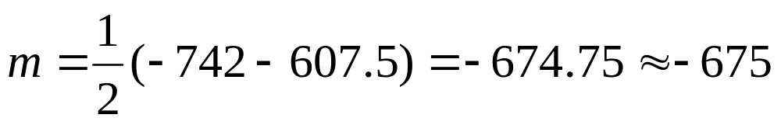
With P(0.04, 67.03) the slope of the secant PR is computed for some R in the following table
The slope m of the tangent at P satisfies:
–742.00 ≤ m ≤ –607.50
We can approximate it by the average value:
R | m_{PR}
(0.00, 100.00) | -824.25
(0.02, 81.87) | -742.00
(0.06, 54.88) | -607.50
(0.08, 44.93) | -552.50
(0.10, 36.76) | -504.50

Slide 11
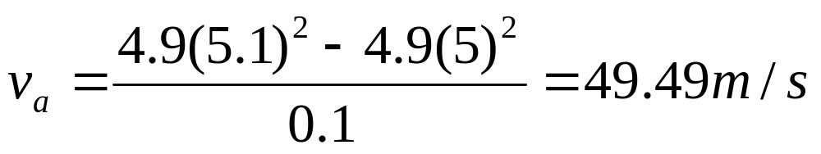
2.1.2 The Velocity Problem
A ball dropped from 450m above the ground is falling down according to Galileo’s Law:
s(t)² = 4.9 t²
where s(t) is the distance traveled by the ball after t seconds
The average velocity in the time interval 5 ≤ t ≤ 5.1 is:

Slide 12
The average velocities in other time intervals are given by:
Time interval | v_{a}
[5, 6] | 53.9
[5, 5.1] | 49.49
[5, 5.05] | 49.245
[5, 5.01] | 49.049
[5, 5.001] | 49.0049
The instantaneous velocity at t = 5 is the limit of the average velocity on the time interval [5, t] as t approaches 0: v = 49m/s

Slide 13
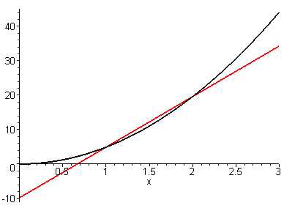
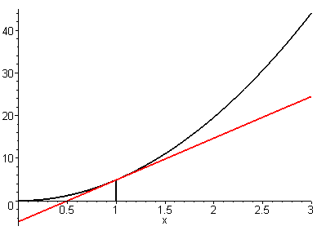
If we draw the graph of s(t)=4.9t² then the average velocity in the interval [a, a+h] is precisely the slope of the secant PQ , where P(a,s(a)), Q(a+h, s(a+h))
Hence the instantaneous velocity at time a is precisely the slope of the tangent Pt at P(a,s(a))
Q
P
t
P
a
a+h

